Slide 1
Experiment no-1

Slide 2
Aim
Introduction to different types of remote sensing data products
Objectives
Define a Remote Sensing data product
List out the types of data products
Discuss about the different types of data formats
Definition: Remote sensing data products are the data from various remote sensing sensors in a suitable and standard form and format that can be readily used by users

Slide 3
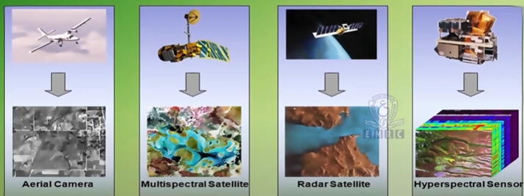
Different Remotely Satellite Data

Slide 4
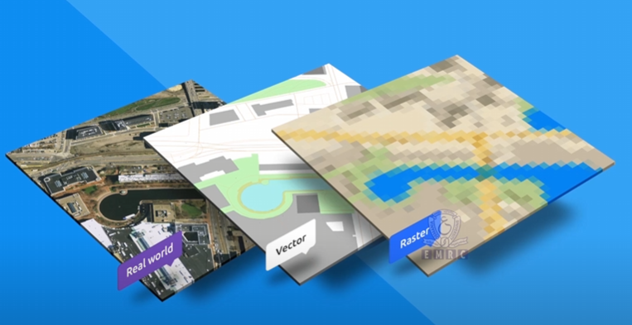
Data type in Geoinformatics

Slide 5
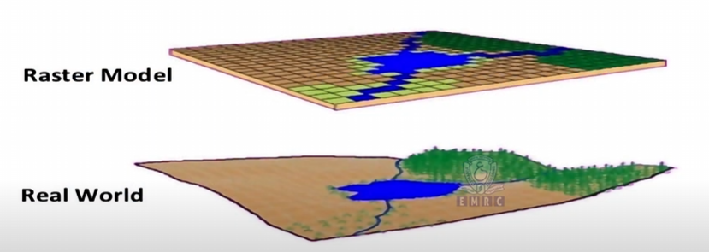
Data in remote sensing

Slide 6
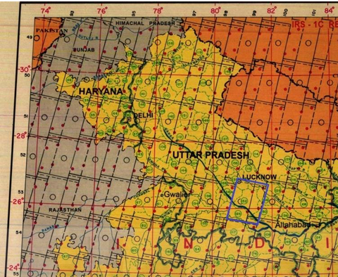
Index Numbers for Data Products
The index number is based on the satellite’s path running from the North Pole to the South Pole. Each satellite pass is given a specific number called the path number or track number. Rows, the East-West lines, intersect these paths, forming a grid-like structure.
For coverage of India (from west to east), path numbers for the LISS sensor range from 88 to 116.
For India (north to south), rows range from 45 to 70.
Example: Lucknow’s IRS image has the index number 100-53 (Path-Row).

Slide 7
Types of Data Products
The types of remote sensing data products depend on:
Level of processing
Output media/scale and
Area of coverage

Slide 8
Types of Data Products
Products Based on Level of Processing
Standard Products – These are products that have been corrected for radiometry and geometry:
Path-Row Based Products
Shift Along Track (SAT) Products
Quadrant Products
Geo-referenced Products
Basic Stereo Products
Area of Interest (AOI) Products
Value-Added Products – These are standard products that are processed according to specific user needs:
Geocoded Products
Merged Products
Ortho Products
Template Registered Products
Derived Products – These products are created by further processing or analyzing standard or value-added products and are ready for user use. Examples include:
Subsidence Map
Dump Slope and Bench Slope Instability
Land Use and Land Cover (LULC) Map

Slide 9
Path-Row Based Standard Products: The sensors record the data along the track/path of the satellite covering a specific width (across the satellite track/path). The user specifies path and row of the scene, sensor, sub-scene (if any), number of scenes, date of pass of the satellite, band numbers/band combination (for photographic products) and the product code (specified by the data provider) as necessary information to procure the desired products from the provider, for example in India, the National Data Centre (NDC) of National Remote Sensing Centre (NRSC), Hyderabad.
Shift Along Track (SAT) Products: If a user's area of interest falls between two successive scenes of the same path (one below the other), the data can be supplied by sliding the scene along the track direction. These products are called Shift-Along-Track Products. In this case, the percentage (10% to 90% in multiple shifts has to be specified by the user in addition to the other necessary information about both scenes.

Slide 10
Quadrant Products: In the IRS series of satellites, LISS Ill full scene (path/ row based products) data has been divided into 4 nominal quadrants designated by letter A, B, C & D. Each of these quadrants is one whole scene of PAN data (B & W data) and is further divided into 9 quadrants. These are numbers from 1 to 9 which are nothing but PAN subscenes. While requesting these products, users need to specify the quadrant number and the details specified for path/row-based products.
Georeferenced Products: Georeferencing transforms the remote sensing data or a map to a coordinate and projection system. This means all the objects/elements in remote sensing data and the map get specific geographic locations regarding longitudes and latitudes. Thus, georeferenced products are north-east oriented products.
Basic Stereo Products: A stereo-pair comprises two images of the same area, acquired from different angles on different dates or the same day. These products generate digital elevation maps or 3D visualization of the study area. Cartosat-l mission provides along-track stereo images.

Slide 11
Types of Data Products contd…
Products Based on Output media/scale
NRSC provides remote sensing products in two types of media:
• photographic media
• digital media.
Photographic products are supplied on film or paper prints. The scale of
these photographic products can range from I to 1:5000.

Slide 12
Products Based on Area of Coverage
Main types of remote sensing data products based on area of coverage
Sl. No. | Types of Remote Sensing Products | Sensors/Satellites
1 | Full Scenes-all bands | PAN from LISS-III & LISS-IV; AWIFS; TM; MLA; PLA; WIFS; OCM; MSMR; MODIS
2 | Full Scenes-specified bands (3 bands for FCC products) | LISS-III, LISS-II, LISS-I, TM,
3 | Full Scenes with Shift-Along Track | PAN & WIFS from LISS-III; AWIFS from LISS-IV; OCM;
4 | Quadrants | LISS-III, TM, OCM
5 | Geocoded Mapsheet based (15’x 15’) | LISS-III, LISS-II, TM, MLA, PLA
6 | Geocoded Floating (15’x 15’) | LISS-III
7 | Geocoded(7½’x7½’) mapsheet/floating | LISS-III, LISS-IV
8 | Full pass/strip data of one array | PAN, OCM, MODIS

Slide 13
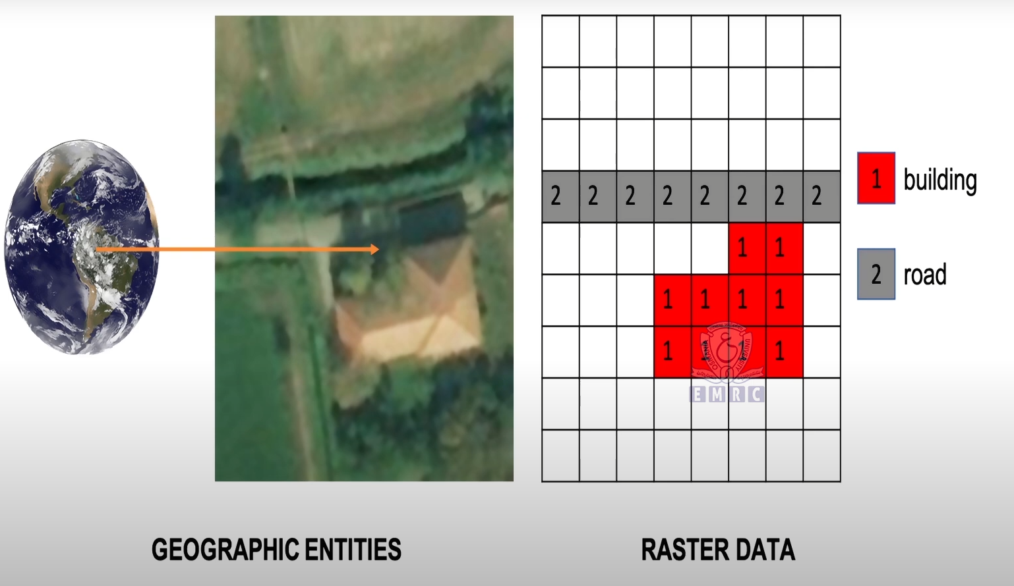



Slide 14
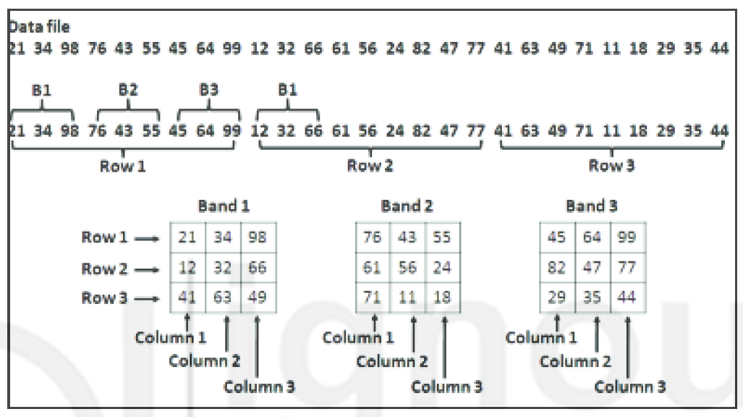
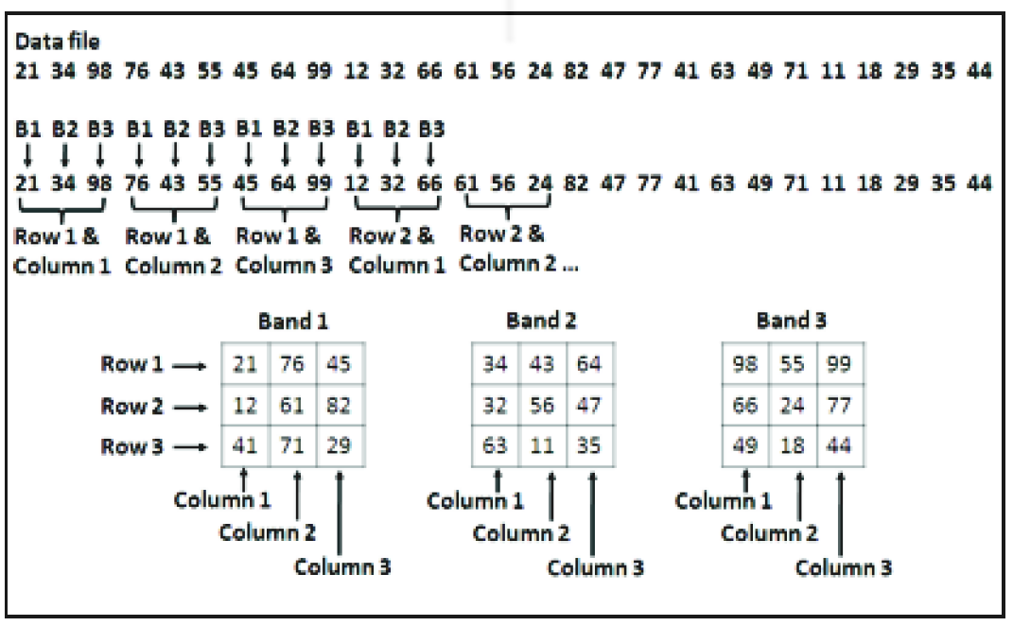
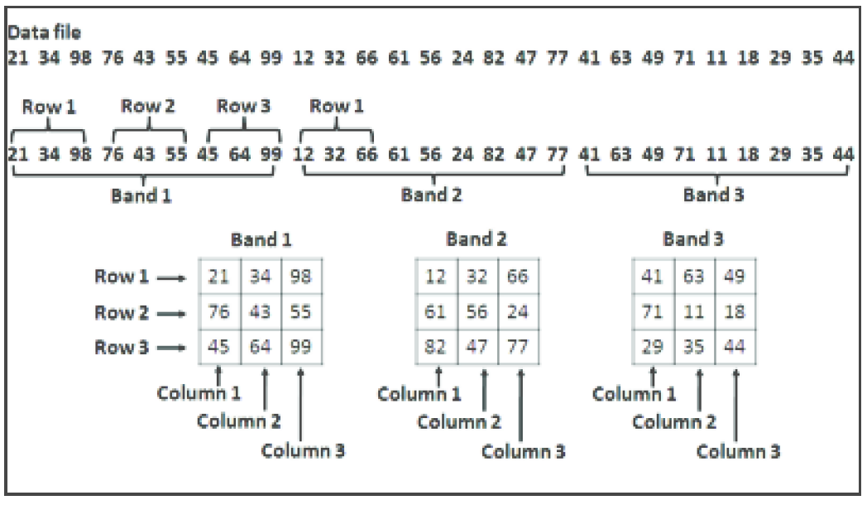
Band Interleaved by Line (BIL)
Types of Data Formats
Types of Data format means Sequence in which different bands of imaged data is stored
Band Interleaved by Pixel (BIP),
Band Interleaved by Line (BIL), and
Band Sequential (BSQ)
Band Interleaved by Pixel (BIP)
Band Sequential (BSQ)

Slide 15
Standards of Data Format for Remote Sensing Data
Digital Data Formats:
Digital products are typically provided in the following formats:
LGSOWG (Landsat Ground Station Operators Working Group) Format
Fast Format
GeoTIFF (Geographic Tagged Image File Format)
HDF (Hierarchical Data Format)
1. LGSOWG Format:
Used for Level-0 (raw data) and Level-2 (corrected data) products.
Contains the following five files:
Volume Directory File
Leader File
Image File
Trailer File
Null Volume Directory File

Slide 16
2. GeoTIFF Format:
Extension of the TIFF format with geographic information.
Provides remote sensing data as an image, making it easy for users to start image processing.
No need for conversion to image data.
IRS-1C/1D data supplied in GeoTIFF format.
File extension: *.tiff
3. HDF Format:
Developed by NCSA (National Center for Supercomputing Applications).
Supports diverse data types (scientific arrays, tables, text, raster images).
Self-describing files: Data types like symbolic, numerical, and graphical data can be bundled in one file.

Slide 17
Exercise
# Acquisition of Remote Sensing Data Product through
i. Bhoonindhi (https://bhoonidhi.nrsc.gov.in/bhoonidhi/index.html )
ii. ESA Copernicus browser (https://browser.dataspace.copernicus.eu/?zoom=5&lat=50.16282&lng=20.78613&demSource3D=%22MAPZEN%22&cloudCoverage=30&dateMode=SINGLE )
iii. USGS Earth explorer (https://earthexplorer.usgs.gov/ )

Slide 18
Tabular representation of different multispectral, hyperspectral, and SAR (Synthetic Aperture Radar) data products available from various satellites.
Key Notes:
Multispectral Data: Captures data in a few discrete spectral bands (e.g., visible, NIR, SWIR).
Hyperspectral Data: Captures data in hundreds of narrow, contiguous spectral bands, enabling detailed material identification.
SAR Data: Uses microwave wavelengths for all-weather, day-and-night imaging, and is particularly useful for surface deformation and change detection.
Applications:
Multispectral: Broad applications in agriculture, forestry, land use, and environmental monitoring.
Hyperspectral: Specialized applications in mineral exploration, vegetation analysis, and precise material identification.
SAR: Applications in disaster management, defense, and monitoring of dynamic Earth processes.

Slide 19
Appendices
Satellite | Country/Organization | Launch Year | Spatial Resolution | Spectral Bands | Key Applications
Landsat 9 | USA (NASA/USGS) | 2021 | 15m (pan), 30m (multispectral) | 11 bands | Land use/land cover, agriculture, forestry, water resources, disaster monitoring
Sentinel-2 | European Union (ESA) | 2015 (2A), 2017 (2B) | 10m, 20m, 60m | 13 bands | Vegetation monitoring, land cover mapping, coastal zone monitoring, disaster management
Sentinel-1 | European Union (ESA) | 2014 (1A), 2016 (1B) | 5m (SAR) | C-band SAR | Flood mapping, oil spill detection, sea ice monitoring, deforestation monitoring
MODIS (Terra/Aqua) | USA (NASA) | 1999 (Terra), 2002 (Aqua) | 250m, 500m, 1km | 36 bands | Climate monitoring, oceanography, vegetation dynamics, wildfire tracking
Pleiades | France (CNES) | 2011 (1A), 2012 (1B) | 0.5m (pan), 2m (multispectral) | 4 bands | Urban planning, defense, disaster response, precision agriculture
WorldView-3 | USA (Maxar Technologies) | 2014 | 0.31m (pan), 1.24m (multispectral) | 8 multispectral, 8 SWIR bands | Defense, mapping, environmental monitoring, mineral exploration
Gaofen-1 | China (CNSA) | 2013 | 2m (pan), 8m (multispectral) | 4 bands | Land survey, environmental monitoring, disaster management, agriculture
Resourcesat-2 | India (ISRO) | 2011 | 5.8m (LISS-IV), 23.5m (LISS-III) | 3-4 bands | Agriculture, forestry, water resources, urban planning
ALOS-2 (PALSAR-2) | Japan (JAXA) | 2014 | 1-3m (SAR) | L-band SAR | Disaster monitoring, forestry, land deformation, ice monitoring
RADARSAT-2 | Canada (CSA/MDA) | 2007 | 1-3m (SAR) | C-band SAR | Maritime surveillance, disaster management, agriculture, ice monitoring
Cartosat-2 | India (ISRO) | 2007 | 0.25m (pan), 1m (multispectral) | 4 bands | Urban planning, infrastructure development, defense, coastal monitoring, DEM Generation
SPOT 6/7 | France (Airbus Defence and Space) | 2012 (SPOT 6), 2014 (SPOT 7) | 1.5m (pan), 6m (multispectral) | 4 bands | Agriculture, forestry, urban planning, disaster management
GCOM-C (Shikisai) | Japan (JAXA) | 2017 | 250m | 19 bands | Climate monitoring, oceanography, vegetation, snow/ice monitoring
CBERS-4A | China/Brazil (CNSA/INPE) | 2019 | 2m (pan), 8m (multispectral) | 4 bands | Agriculture, deforestation monitoring, urban planning, disaster management
NISAR | USA/India (NASA/ISRO) | Planned (2024) | 3-10m (SAR) | L-band and S-band SAR | Earth deformation, ecosystem monitoring, cryosphere studies, disaster management
Description of current major imaging observation satellites available in the world*

Slide 20
Key Notes:
Spatial Resolution: Refers to the smallest object or detail that can be detected in the imagery.
Spectral Bands: Indicates the number of wavelength ranges captured by the satellite sensors.
SAR (Synthetic Aperture Radar): Used for all-weather, day-and-night imaging.
Applications: Highlight the primary uses of the satellite data.

